Slide 1
GROUP 13
Technology for everyone

Slide 2
Our Team
Our Team
Supervisor :- Dr. Prasad Wimalarathne Mentor :- Ms. S.S. Edirisinghe
1). W.N.D.D.Sanjaya | 2015/CS/124 | 15001245
2). S.D.L.H.Maheeshanake | 2015/CS/085 | 15000852
3). W.S.M.Rathnasekara | 2015/CS/113 | 15001131
4). L.N.Anuradha | 2015/CS/014 | 15000141
5). P.H.Samarasekara | 2015/IS/065 | 15020657
6). G.W.M.W.K.M.Sirisena | 2015/IS/786 | 15020762

Slide 3

Introducing
Reporters Managing System
For News Companies

Slide 4

Our Client

Slide 5
Studying the Current real world systems
We visited few companies to study various types of systems.
Various companies use various type of technology.
That helped to get an idea about technology.
Understood the common Issues of that process.

Slide 6
Issues we found
Miscommunication between coordinator and the reporter
Allocating a news is fully manual process through a call.
Its hard to view each reporters activity for a one person at one time
Time wasting in finalizing the monthly payment of a reporter.
Some important news can be missing
Its too complicate to handle this process for a one or few people.

Slide 7

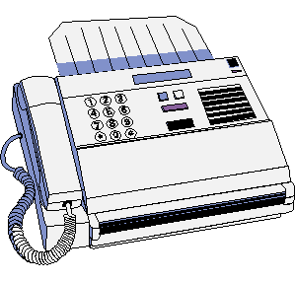



Current Process
Coordinator : search for a reporter
Inform via a Call
Inform via Fax
News Department
Reporter : cover the news

Slide 8



Solution
Coordinator : enter the news
Automatically send alerts
Inform via Fax
News Department
Reporter : cover the news

Slide 9






SYSTEM HIERARCHY
NEWS DIRECTOR
NEWS COORDINATOR
REPORTER
REPORTER
REPORTER
REPORTER

Slide 10
Objectives
User friendly application to the provincial reporters
Convert the manual system into a standard computerized system
Minimize the unclear situations such as connection/signal problems when we are using telephone calls to co-ordinate.
Inform all the provincial reporters about the coverages and news of their area
Reporters also can inform about the news in their city to the head office
Inform others when someone has been assigned to a specific task
Web application to the co-ordinators to control the work flow

Slide 11
Functional requirements
Coordinator - Web Based System
1. Log in to the system
2. Send new news items to reporters
3. Receive news items from reporters
4. View pending news, scheduled news, monthly summary and reporter details
5. Send messages to reports

Slide 12
Functional requirements
Reporter – Mobile App
1. Log in to the system
2. Send news to the media corporation
3. View upcoming news, monthly news summary, inbox and monthly salary

Slide 13
Non-functional requirements
Usability
user friendly and attractive GUI.
Availability
Even if there’s no connection the user have access to see his salary and upcoming events and some features.
Reliability
Access limited only to the privileged people
Performance
Quick responding

Slide 14
BENEFITS
Can share information effectively
Improve reporter relationship by news director with the news coordinator
Can access to the information anytime
Reporters can get notifications about their new tasks

Slide 15

ANALYSIS

Slide 16
TECHNICAL FEASIBILITY
Mobile app will run on any mid-range tablet or smartphone
Uses HTML/CSS/JavaScript for development the web site
Uses android studio for development the mobile app
Technical aspects of the development are well within the group’s ability. Team is currently researching on a suitable technological stack to be used

Slide 17
OPERATIONAL FEASIBILITY
The mobile app will provide simple and intuitive interfaces to the reporter.
System does not require any other hardware components
Contract problems, so this system is ideal.

Slide 18
CULTURAL FEASIBILITY
It is a measure of how the solution is compatible with the organizational environment and how well the system works in the organization.
The mobile app system will be easy to access by reporters.
This new system will allow reporters and staff to save time and work efficiently.

Slide 19
SCHEDULE FEASIBILITY
A timeframe is not a client requirement, however it is a course objective.
Number of work hours:
Weekdays = 4
Weekend = 2
Number of member = 6
Man-hours per week = (4+2) * 6 = 36
Estimated number of weeks = 42
Estimated total of man hours = 36 * 42 =1512

Slide 20
Development Methodologies
Incorporate prototyping
Allow some of the stages to overlap
Can implement easy areas before harder ones
integrate feedback from one phase to another
Therefore we use modified waterfall model

Slide 21


Slide 22
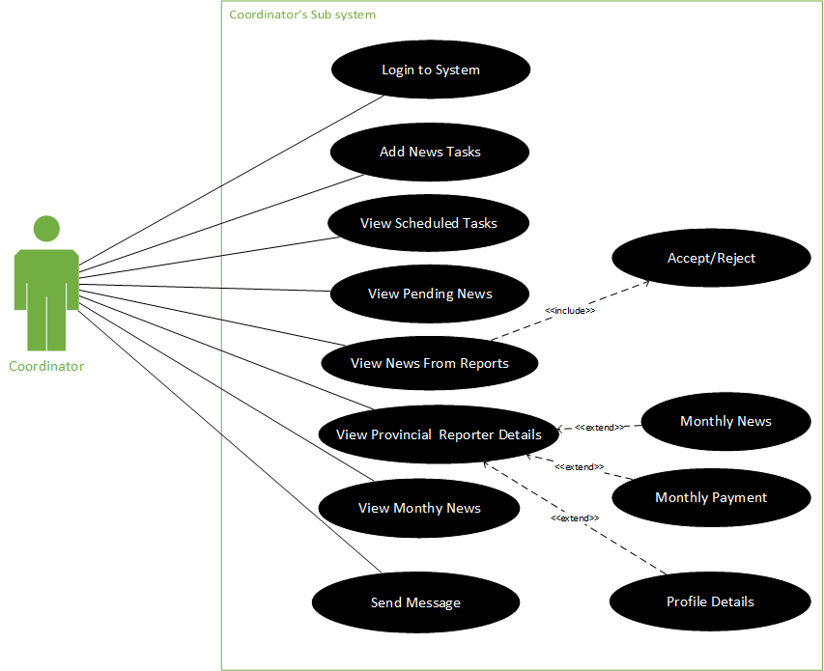

Slide 23
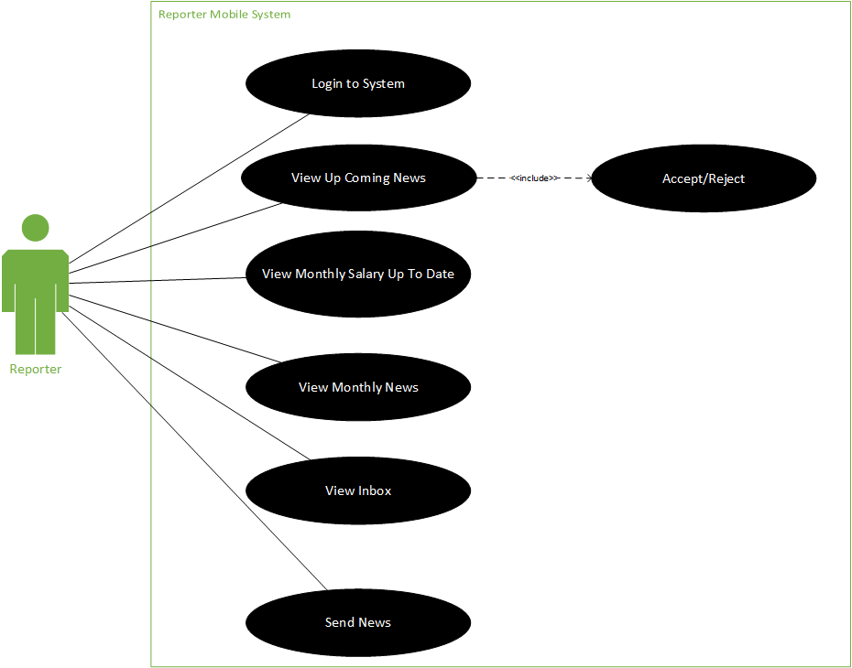

Slide 24



Technologies we use

Slide 25
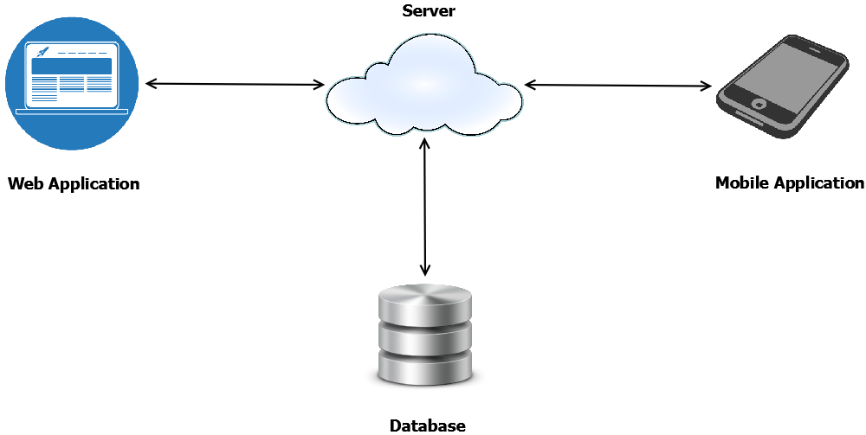
HIGH LEVEL ARCHITECTURE

Slide 26



DELIVERABLES
Web Application
Mobile Application
User Manual

Slide 27

Delivery Plan

Slide 28
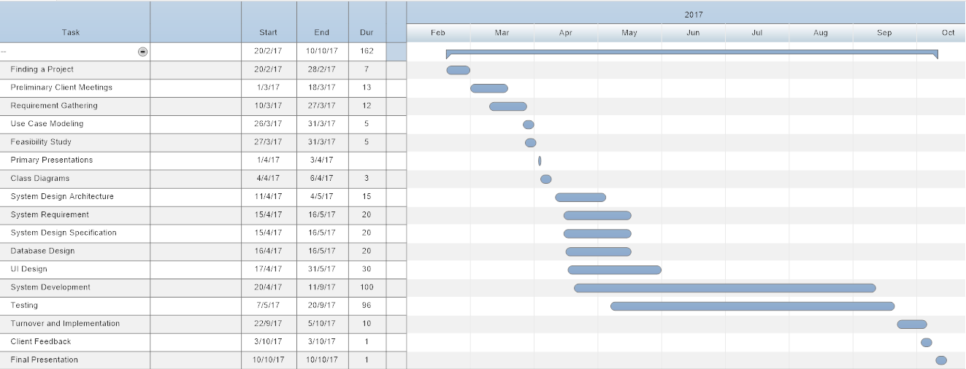
Gantt Chart

